Slide 1

IOT MINI PROJECT
EMERGENCY ALERT HELMET
SANJAY S (210701231)
SHRIRAM KUMAR A N (210701247)

Slide 2


INTRODUCTION
The Emergency Alert Helmet represents a pioneering advancement in the field of road safety technology. By integrating sophisticated sensors and communication modules into a wearable device, it transforms a traditional piece of safety gear into a smart, life-saving tool.
Road accidents often result in critical injuries, where every minute counts for the survival of victims. This helmet addresses the crucial gap between the occurrence of an accident and the arrival of medical help by instantly alerting emergency services and designated contacts upon impact detection
Equipped with a force resistive sensor, GPS module, GSM module, and Arduino microcontroller, the helmet seamlessly combines hardware and software elements to create a comprehensive emergency response system. Each component plays a vital role in detecting accidents and relaying crucial information to responders.
Unlike conventional methods of calling for help after an accident, which may be delayed or hindered by injuries, the helmet's automatic triggering system ensures that assistance is summoned immediately upon impact detection. This automation removes the reliance on the victim's ability to communicate their distress, enhancing overall response efficiency.

Slide 3
PURPOSE OF THE PROJECT
The primary purpose of the Emergency Alert Helmet is to increase the chances of survival for accident victims by reducing the time it takes for medical assistance to arrive at the scene. By alerting emergency services and contacts immediately after an impact, the helmet facilitates swift intervention, potentially saving lives.
Another key objective of the project is to streamline the emergency response process. By providing accurate location data along with the alert message, the helmet enables responders to pinpoint the exact location of the accident, eliminating delays associated with locating the scene.
Beyond individual cases, the widespread adoption of this technology has the potential to make significant contributions to public health. By reducing the number of fatalities and serious injuries resulting from road accidents, the project aims to alleviate the burden on healthcare systems and improve overall societal well-being.

Slide 4

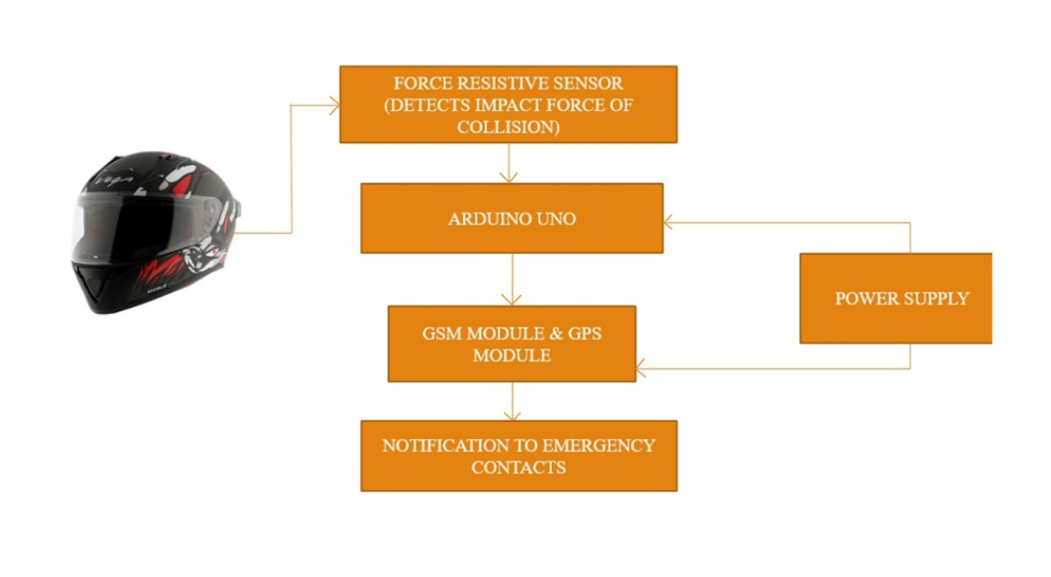

PROPOSED SOLUTION

Slide 5
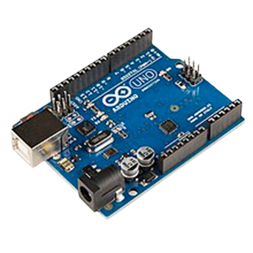
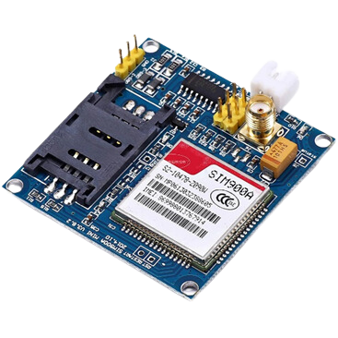
COMPONENTS USED
HARDWARE USED:
ARDUINO UNO:
The Arduino Uno is an open-source microcontroller boar based on the Microchip ATmega328P microcontroller (MCU) and developed by Arduino.cc
GSM MODULE:
SIM900A is an ultra compact and reliable wireless module. This is a complete GSM module in a SMT type and designed with a very powerful single-chip processor integrating AMR926EJ-S core, allowing you to benefit from small dimensions and cost-effective solutions.

Slide 6

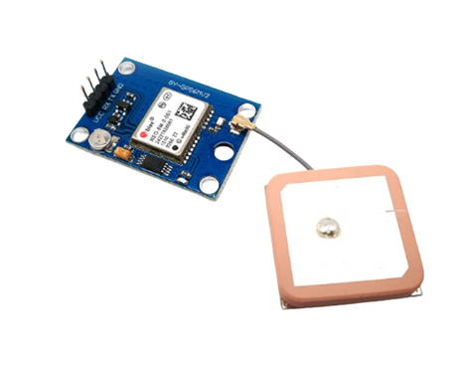

COMPONENTS USED
FORCE RESISTIVE SENSOR:
A force-sensing resistor is a material whose resistance changes when a force, pressure or mechanical stress is applied. They are also known as force-sensitive resistor and are sometimes referred to by the initialism FSR.
GPS MODULE:
The NEO-6M GPS Module offers high-precision positioning capabilities in a compact design, ideal for integration into various devices.
SOFTWARE USED :
ARDUINO IDE:
The Arduino Integrated Development Environment - or Arduino Software (IDE) - contains a text editor for writing code and it connects to the Arduino hardware to upload programs and communicate with them.

Slide 7
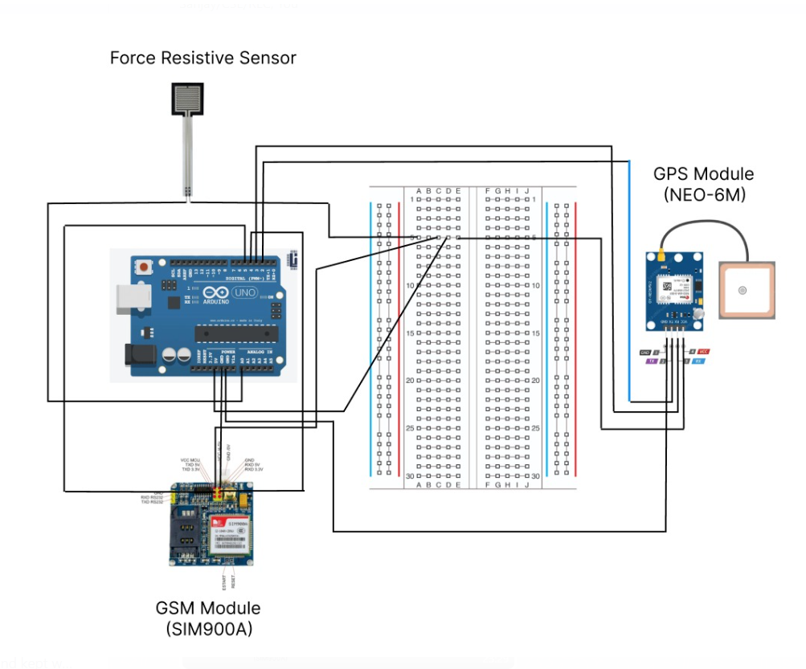
CIRCUIT DIAGRAM

Slide 8
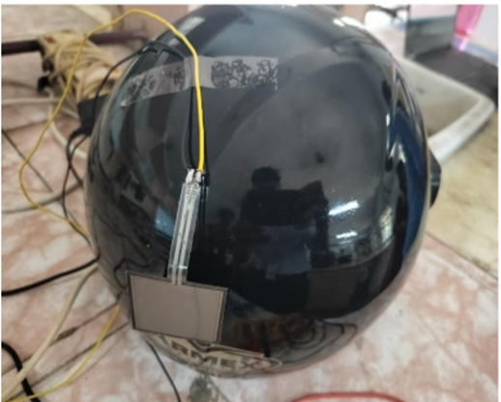
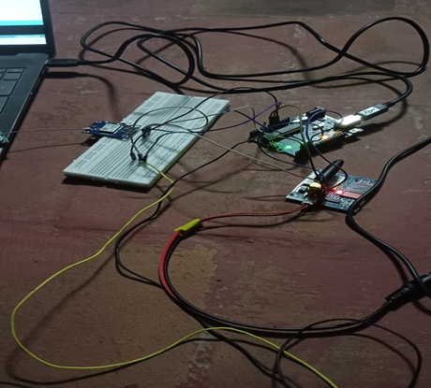
IMPLEMENTATION RESULTS

Slide 9
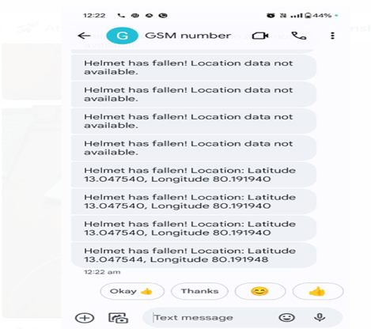
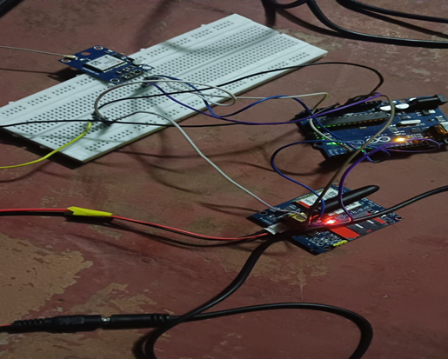
IMPLEMENTATION RESULTS

Slide 10
CONCLUSION
The Emergency Alert Helmet significantly improves road safety by ensuring immediate detection of accidents and swift notification to emergency services. This rapid response can dramatically increase the chances of survival and reduce the severity of injuries for accident victims.
By integrating advanced sensors, GPS, and communication modules with an Arduino microcontroller, the helmet showcases the effective use of technology in enhancing emergency response capabilities. This innovation sets a new benchmark for smart safety gear.
The automatic alert system embedded in the helmet bridges the crucial gap between accident occurrence and medical intervention, potentially saving countless lives. The provision of precise location data ensures that help reaches the accident site promptly.

Slide 11
FUTURE ENHANCEMENTS
GYROSCOPE
ACCELEROMETER(MPU-6050)

Slide 12


THANK YOU

